Slide 1
VET Workforce Blueprint
Discussion with acTA
Monday 11 December

Slide 2
Current workforce profile and future trends​
Current VET workforce profile
Future VET workforce trends
RTOs are already experiencing workforce shortages across most industries. This is felt most acutely in:
Regional and remote contexts
Certain sectors with high industry demand
Areas requiring specialised skills
VET is a rewarding and attractive career :
It is seen as a rewarding career and an opportunity to ‘give back’
It is seen as an opportunity to transition into a different career from industry
The workforce is older compared to other industries
The workforce is continuing to age. While this bring expertise and experience, it presents some challenges:
Employers need to consider how to manage, support and retain older workers
The sector needs to consider how to recruit the next generation
In TESOL/LLND, attaining relevant qualifications requires a longer time commitment, making it difficult to quickly address the workforce pipeline
There is increased demand on VET workforce digital capabilities, both in terms of:
Teachers engaging with digital technologies, and
Teaching students digital literacy skills
There are more casual or non-permanent roles than the wider labour market.
Highly mobile workers that make between one and five changes in employment during their career.

Slide 3
VET workforce barriers
There are a range of complex, interconnected barriers to attracting, retaining and developing the TESOL/LLND VET workforce.
Barriers to entry, including challenges associated with VET qualification requirements and the qualification requirements of accredited training products
High administrative and compliance burden
Complexity and impact of operating environment
Lack of availability of targeted professional development opportunities and resources
Challenges due to complex student needs, including additional pastoral care
Impact of training products, including focus on assessment
Challenges related to digital capability needs (students and practitioners)
Lack of clear career structure and progression pathways
Challenges relating to employment conditions, including lack of secure employment opportunities
Challenges associated with regional and remote locations, including attraction and retention of staff
3

Slide 4
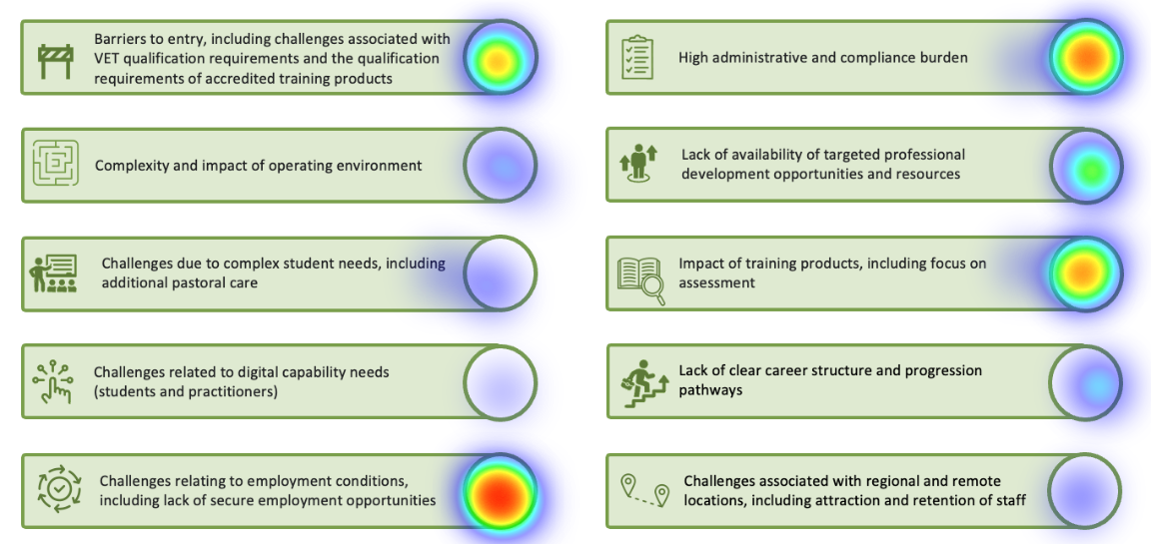
Barriers heatmap results
Do these results align with your thinking?
Do any of these results surprise you?

Slide 5
Potential action areas from conversations with broader VET
Potential action areas:
Examples of what this could look like:
Promoting the image and status of the VET workforce
Leverage known motivations for entering the VET workforce
Increase awareness and understanding of available VET roles
Promote the value of working in the VET workforce and entry pathways
Enabling and promoting entry pathways into the VET workforce
Improve incentives to attract new entrants
Incentivise TAE training package enrolments and completions leading to engagement in the VET workforce
Use a ‘stackable’ approach for people from industry to complete TAE qualifications
Continuing professional support, development, and progression
Improve induction and mentoring processes
Develop updated national capability frameworks and/or professional standards
Professional development in areas of high need, i.e., supporting students with diverse needs
Strengthening partnerships between industry and RTOs
Support transitions from industry to VET through joint VET/industry appointments
Increase and promote flexible pathways between industry and VET, such as through traineeships and other programs
Encourage RTOs to engage with industry on solutions to support their VET workforce
Improving workforce data and planning
Consider developing a national, consistent, regular data VET workforce collection
Use evidence base for more effective workforce strategy and planning

Slide 6
Activity: Actions
For each priority barrier, please consider:
What action/s could address this?
What it looks like in practice in the LLND/TESOL teaching context
This could include new actions, or existing examples where you’ve seen success
You identified some priority barriers / challenges. What actions could address these?
Top 3 barriers/challenges you identified:
How can each action be implemented?
Impact of training products, including focus on assessment
1
Who needs to be involved?
2
What are the key enablers and risks you anticipate in implementing this action?
High administrative and compliance burden
Challenges relating to employment conditions, including lack of secure employment opportunities
3
What does success look like for this action?

Slide 7
Thank you
Claire Baldwin
Director, VET Student Policy, DEWR
VETWorkforce@dewr.gov.au

